Slide 1
Detecting Hate Speech in Memes

Slide 2
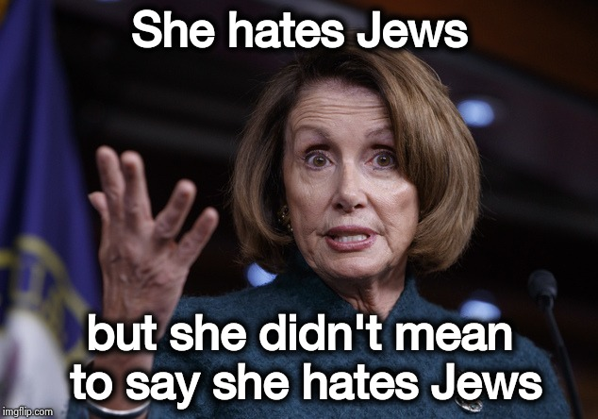
Proposed Methodology
Input
She hates Jews but she didn't
mean to say she hates Jews
Text Module (Sbert)
GMU
Performance Evaluation
Visual Module (Xception)
Output
Hateful/Non-Hateful

Slide 3
Modals for Text Embeddings
Word 2 vec
GloVe
Fast text
Bert
Sbert
Why Sbert ?
this gives sentences embeddings.
contextual meaning is considered.

Slide 4
Xception Model
Why Xception ?
It implements depthwise Separable Convolutions,which helps in reducing computation time(9 times), parameters
Can be used in Multimodal Nets.
Large gains in convergence speed, as well as a significant reduction in model size
Can be used for multi-label classification tasks.

Slide 5
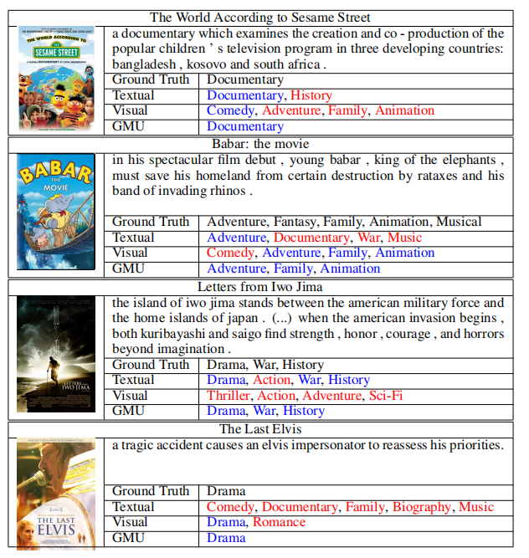
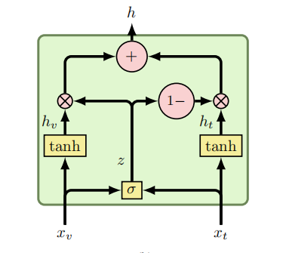
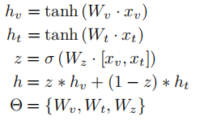
GATED MULTIMODAL UNITS FOR INFORMATION FUSION
https://arxiv.org/pdf/1702.01992.pdf

Slide 6
References
Sentence-BERT: Sentence Embeddings using Siamese BERT-Networks , Nils Reimers and Iryna Gurevych.
Franc¸ois Chollet Google, Inc. - Xception: Deep Learning with Depthwise Separable Convolutions,4 Apr 2017, https://arxiv.org/pdf/1610.02357.pdf

Slide 7
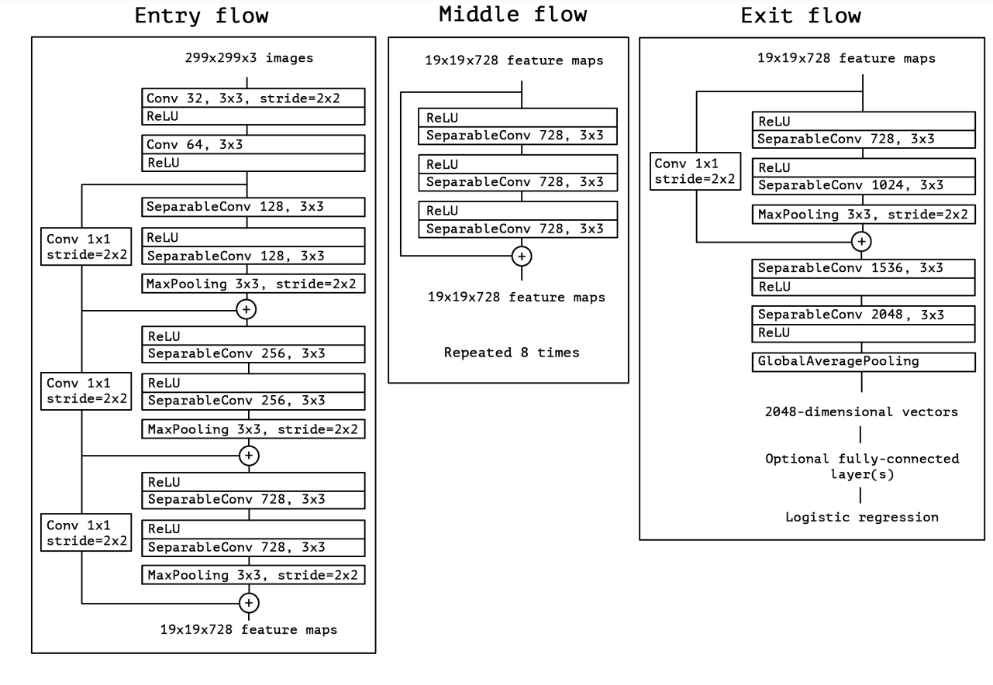
Xception Architecture :

Slide 8
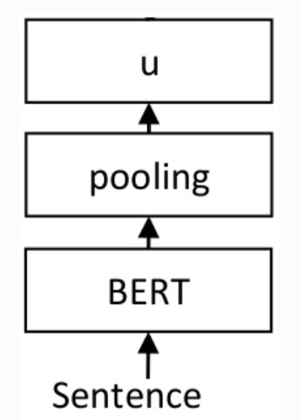
Sentence-BERT: Sentence Embeddings using Siamese BERT-Networks

Slide 9
Thank You

